Slide 1

Recommendation System

Slide 2
AGENDA
Introduction
What and Why EDA?
Understanding Market Basket Analysis
Implementation

Slide 3

Exploratory Data Analysis
Exploratory data analysis is an approach of analysing data sets to summarize their main characteristics, often using statistical graphics and other data visualization methods.
Why?
It can help identify obvious errors, as well as better understand patterns within the data, detect outliers, find interesting relations among the variables

Slide 4


Slide 5
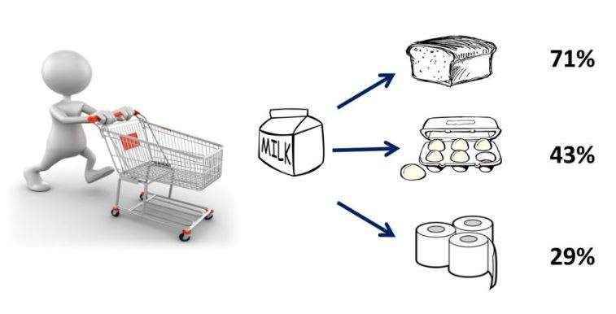
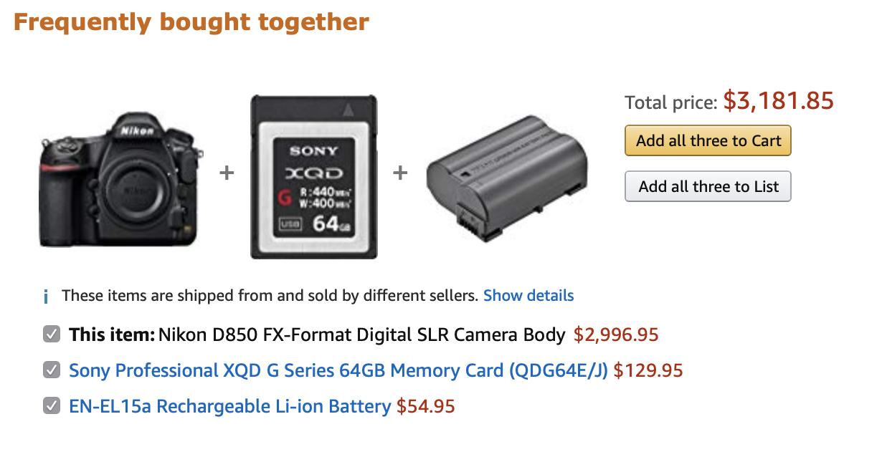
Market Basket Analysis
Market basket analysis is a technique used by companies to increase sales by better understanding customer purchasing patterns.
It takes purchase history data to find product groupings, as well as products that are likely to be purchased together.

Slide 6
Conclusion
EDA
Top 10 First Choices
Trending Items
Deal Of The Day
Frequently Bought Together

